Slide 1

Presentation on New age shopping
By – Aayush Basnet ( 171601)
Jiwan Gharti (171719)
Jayas Sapkota (171718)
Shiva Prasad Chapagain (171748)
Supervisor: Mr. Prakash Paudal

Slide 2

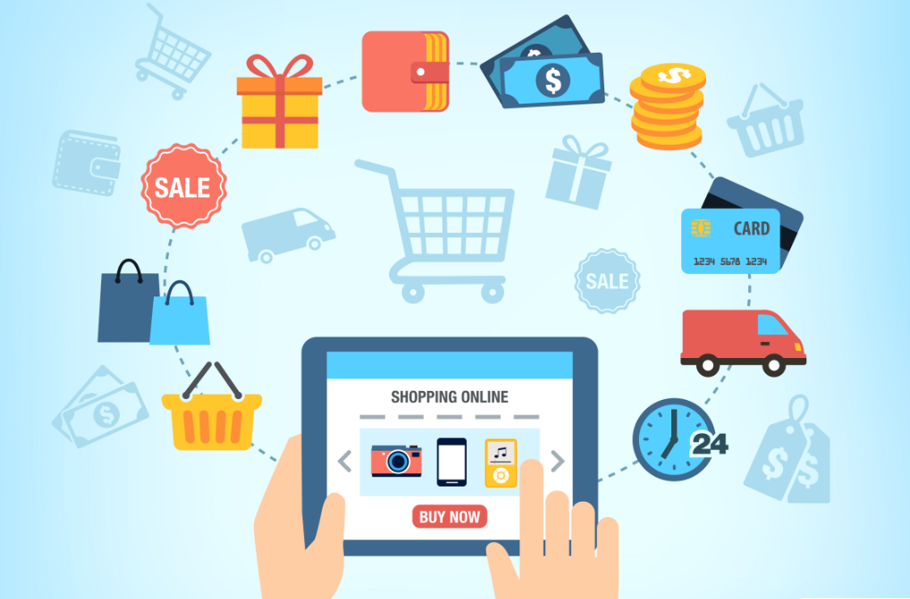
NEW AGE SHOPPING
A NEW TYPE OF STORE-FRONT.

Slide 3
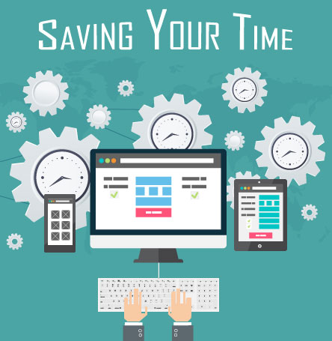

Slide 4

Introduction
A form of electronic commerce
Allows consumers to directly buy goods or services from a seller over the Internet using a web browser.
Permits the customer to submit online order
Allows vendor to sell goods without needing any physical store.
Also known as “Bill me later shopping” and “Credit shopping”

Slide 5
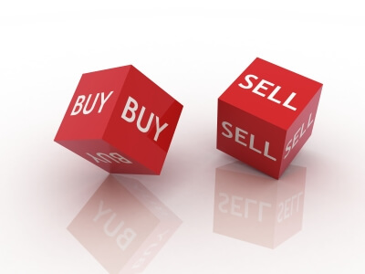
Goal
To provide user interface where customers can do online shopping in easy way.
Selling a service or product online
To reach out to a larger Audience.
To save time of buyer.
To modernize the primitive way of shopping.

Slide 6

TOOL SPECIFICATION
HTML
CSS
JAVASCRIPT
PYTHON
DJANGO
BOOTSTRAP
PostgreSQL

Slide 7
BENEFITS/NOVELITY OF THE APPLICATION
BUYER
Saves time of buyer,
24/7 hours service,
Compare products before buying,
SELLER
Flexibility,
Gain customers globally,
Can run business from anywhere.

Slide 8
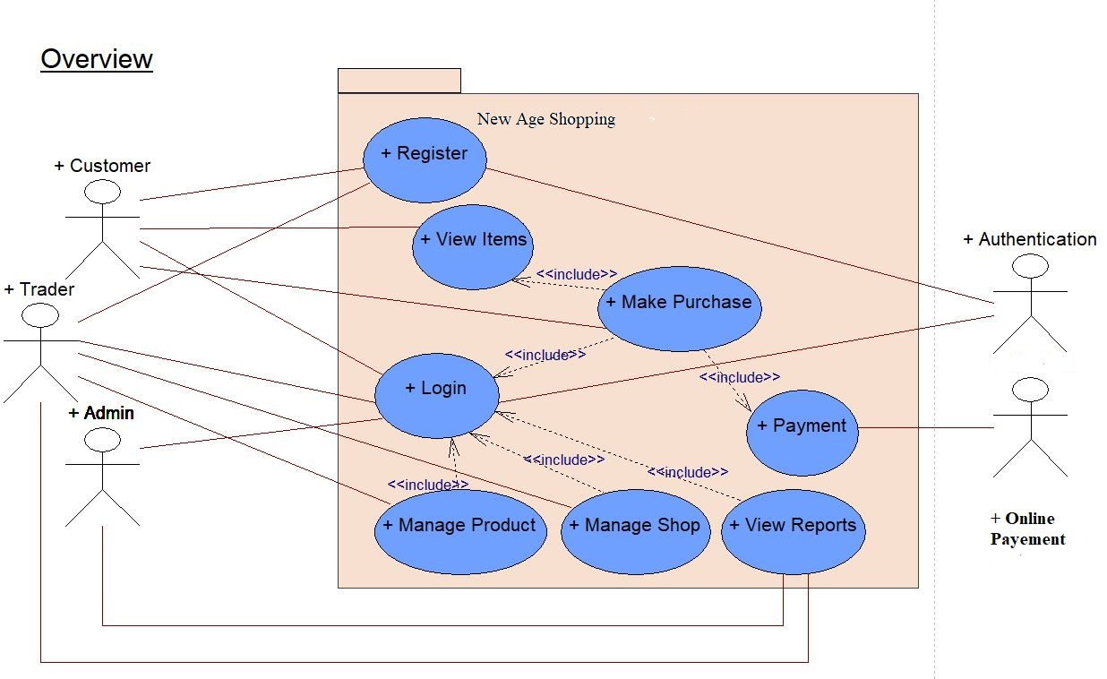
Use Case Diagram

Slide 9
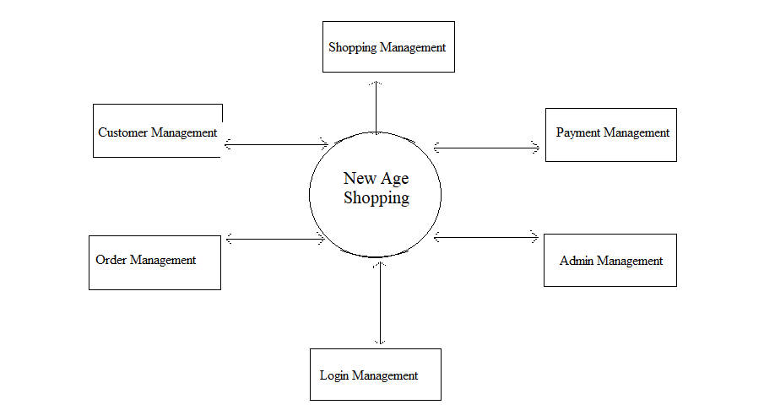
Data Flow Diagram

Slide 10
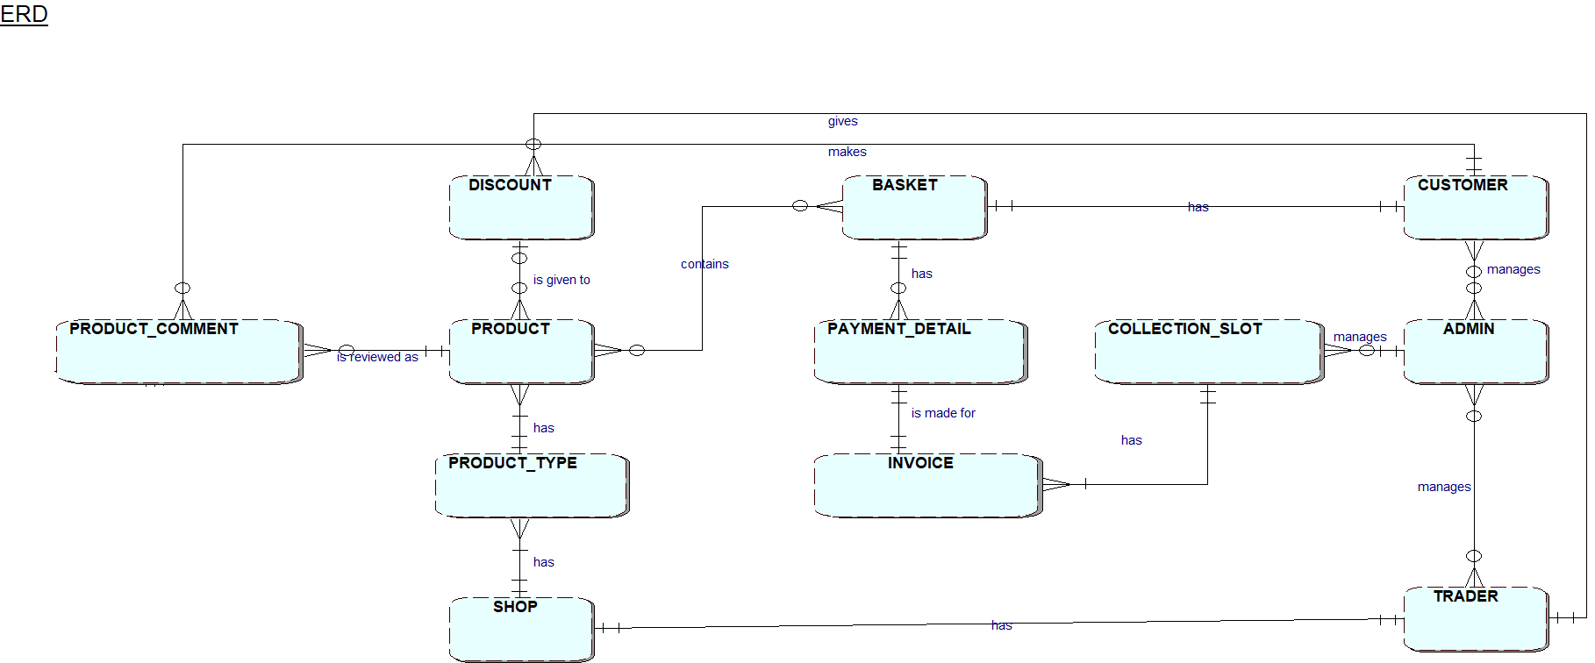
ER Diagram

Slide 11
CONCLUSION
Determining the market analyzing is always been challenging work for business analysts.
Thus, through online platform data can be collected which includes what product customer desires,
Large geographical areas can be covered,
Opens up doors to many small retailers,
Win-win situation for both consumer and sellers.

Slide 12

Future Work
Many modifications and domain extensions are planned:
Improving the search engine.
Product recommendations
Payment with Card, Khalti
Inventory management
Making website fully responsive

Slide 13

Questions?

Slide 14
Reference
https://sites.google.com/site/shoppingonlineexperience/social-aspect/conclusion
https://www.freeprojectz.com/dfd/online-shopping-system-dataflow-diagramhttps://www.slideshare.net/iammridul/stock-market-prediction-49058866?from_action=save

